Slide 1
Installation Guide
(Project Template – codelabor-struts1-template)
2008. 12. 09
CODELABOR
Shin Sang Jae (codelabor@gmail.com)

Slide 2
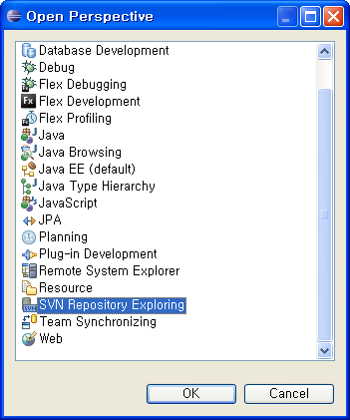
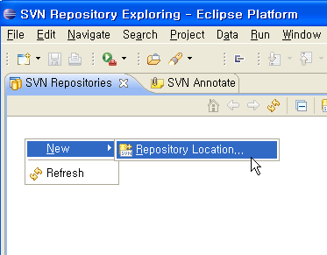
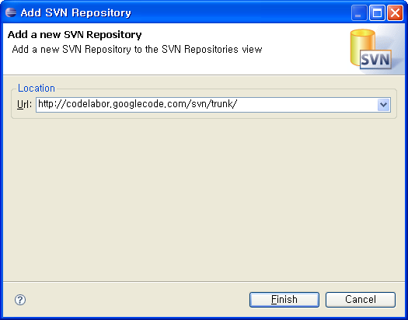
Project Template
Repository
SVN URL: http://codelabor.googlecode.com/svn/trunk/

Slide 3
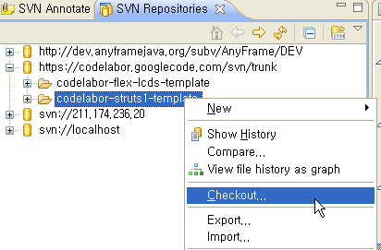
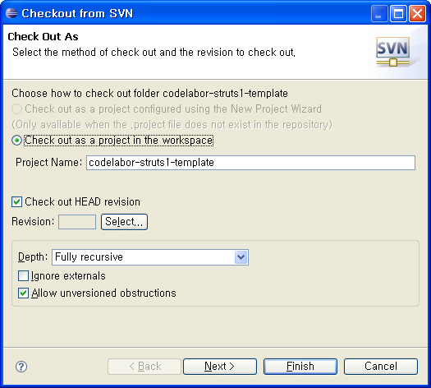
Project Template
Checkout
Checkout Project

Slide 4
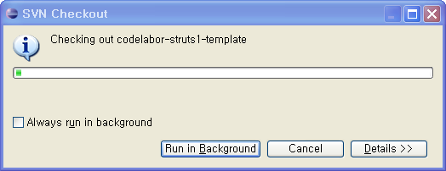
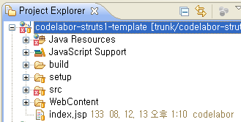
Project Template
Import
Import Project

Slide 5
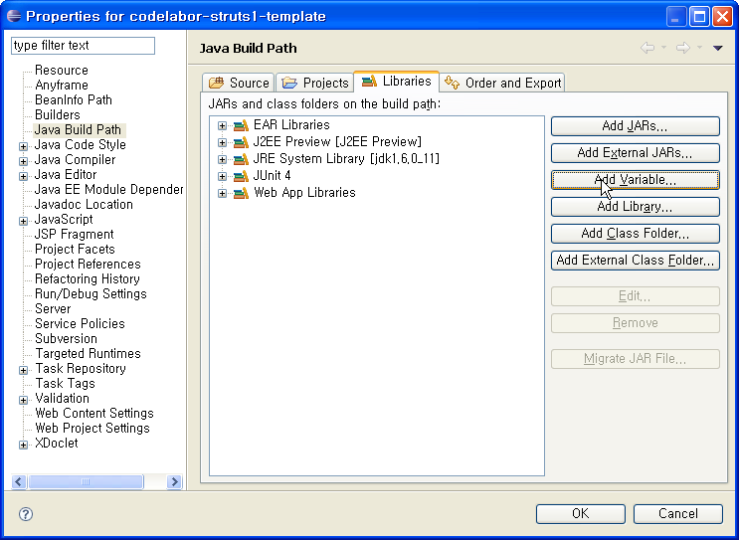
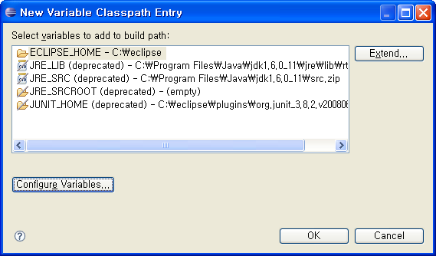
Project Template
Jeus Library
Add Classpath Variable

Slide 6
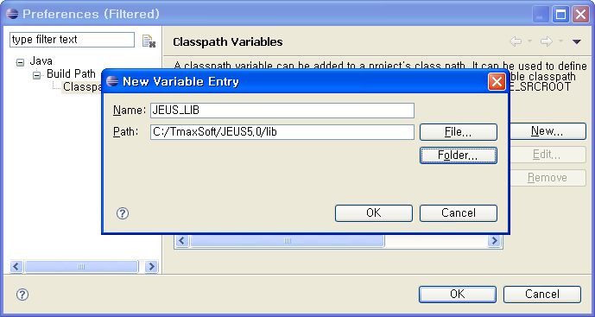
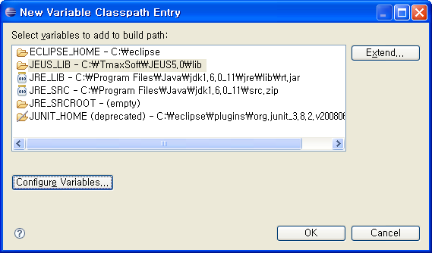
Project Template
Jeus Library
Variable Name: JEUS_LIB
Variable Path: C:/TmaxSoft/JEUS5.0/lib

Slide 7

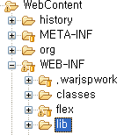

Project Template
Spring Library
Official Site URL: http://www.springframework.org/
Download Site URL: http://www.springsource.org/download
Download File: spring-framework-2.5.6.zip
Unzip File
Copy Files: spring-framework-2.5.6/dist/modules/*.*
Destination Directory: C:\workspace\codelabor-struts1-template\WebContent\WEB-INF\lib

Slide 8
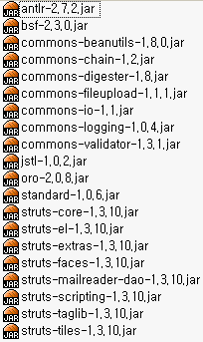
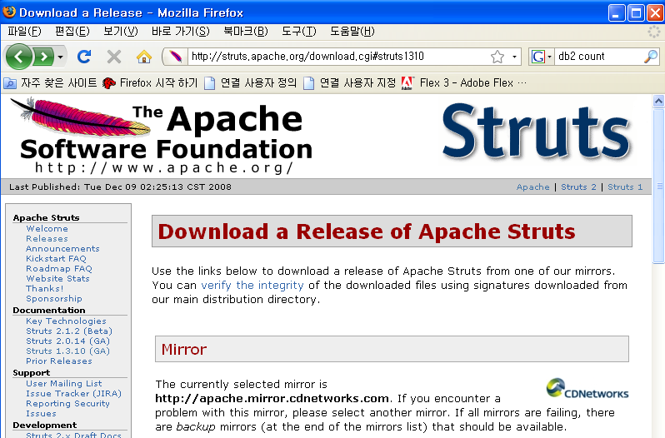

Project Template
Struts Library
Official Site URL: http://struts.apache.org/1.3.10/index.html
Download Site URL: http://struts.apache.org/download.cgi#struts1310
Download File: struts-1.3.10-all.zip
Unzip File
Copy Files: struts-1.3.10/lib/*.*
Destination Directory: C:\workspace\codelabor-struts1-template\WebContent\WEB-INF\lib

Slide 9
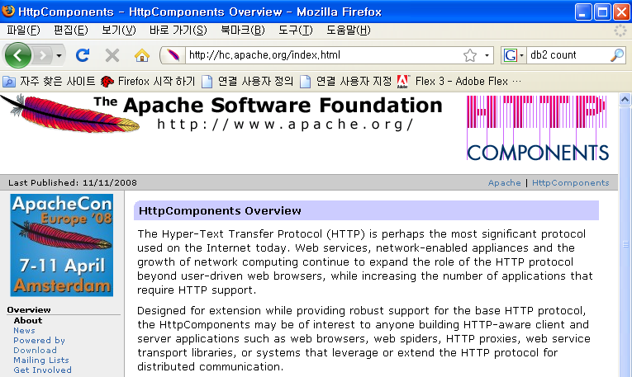

Project Template
HttpClient Library
Official Site URL: http://hc.apache.org/
Download Site URL: http://hc.apache.org/downloads.cgi
Download File: commons-httpclient-3.1.zip
Unzip File
Copy Files: commons-httpclient-3.1.jar
Destination Directory: C:\workspace\codelabor-struts1-template\WebContent\WEB-INF\lib

Slide 10
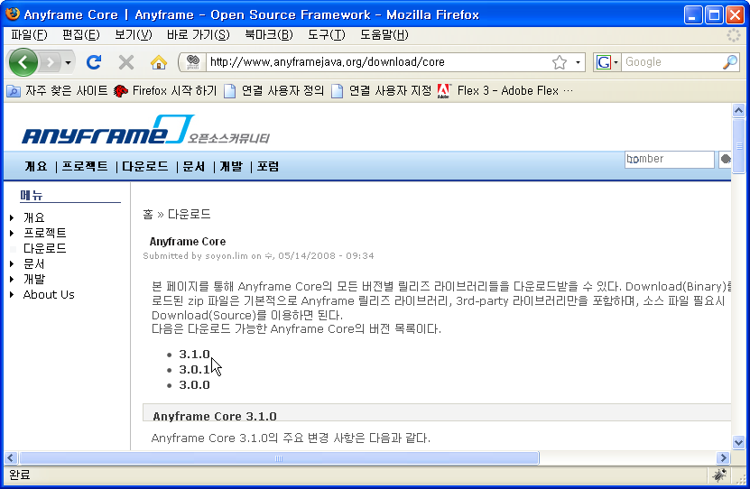

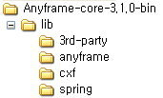
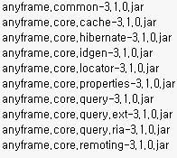
Project Template
Anyframe Library
Official Site URL: http://www.anyframejava.org
Download Site URL: http://www.anyframejava.org/download/core#310
Download File: Anyframe-core-3.1.0-bin.zip
Unzip File
Copy Files: Anyframe-core-3.1.0-bin\lib\anyframe\*.*
Make Directory: C:\workspace\codelabor-struts1-template\WebContent\WEB-INF\lib
Destination Directory: C:\workspace\codelabor-struts1-template\WebContent\WEB-INF\lib

Slide 11
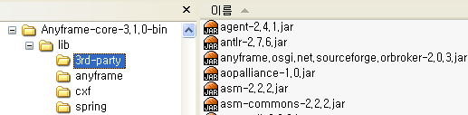
Project Template
Anyframe 3rd-Party Library
Official Site URL: http://www.anyframejava.org
Download Site URL: http://www.anyframejava.org/download/core#310
Download File: Anyframe-core-3.1.0-bin.zip
Unzip File
Copy Files: Anyframe-core-3.1.0-bin\lib\3rd-party\*.*
Destination Directory: C:\workspace\codelabor-struts1-template\WebContent\WEB-INF\lib

Slide 12
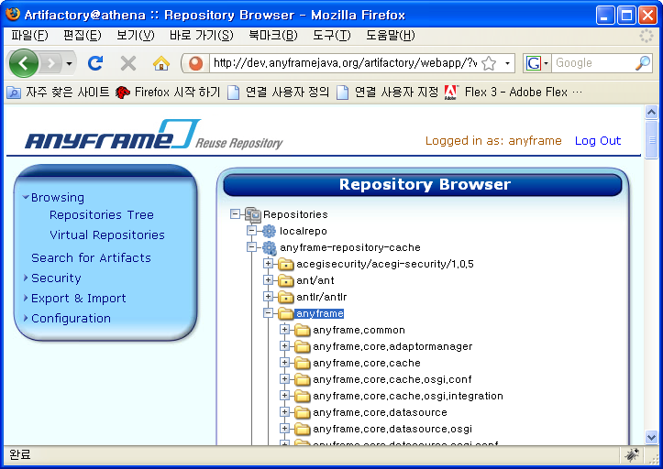
Project Template
Anyframe Patch Library
Official Site URL: http://www.anyframejava.org
Download Site URL: http://dev.anyframejava.org/artifactory
Username: anyframe
Password: anyframe0
Browse repository tree: anyframe-repository-cache/anyframe/

Slide 13
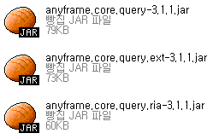
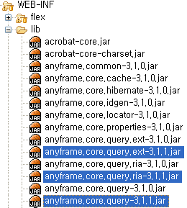
Project Template
Anyframe Patch Library
Download File:
  anyframe.core.query-3.1.1.jar
  anyframe.core.query.ext-3.1.1.jar
  anyframe.core.query.ria-3.1.1.jar
Destination Directory: C:\workspace\codelabor-struts1-template\WebContent\WEB-INF\lib

Slide 14
Project Template
Unused Library
Delete File:
  antlr-2.7.2.jar
  anyframe.core.query-3.1.0.jar
  anyframe.core.query.ext-3.1.0.jar
  anyframe.core.query.ria-3.1.0.jar
  commons-beanutils-1.7.0.jar
  commons-digester-1.7.jar
  junit-3.8.1.jar

